Slide 1
Moving to a New Location
Philip Kinney

Slide 2
Introduction
Problem: Moving your family across the country can be difficult. What if there was a way to make the transition easier?
Solution: Create a simple, two tier analysis that can be customized for any location
Tier 1: Analyze the county
Tier 2: Analyze the neighborhood

Slide 3
Hypothetical Example:
A young family knows they will be moving to Chester County, Pennsylvania, but they are not sure where is the best place for them to live
They want to live close to various venues and activities (within a 10 mile radius) so they don’t have to drive too much
The venues and activities that they want to live close to are:
Church
Grocery Store
Gas Station
Park
Shopping Mall
Thai Restaurant
Museum
Zoo
Golf Course
Grade School
Public Library

Slide 4

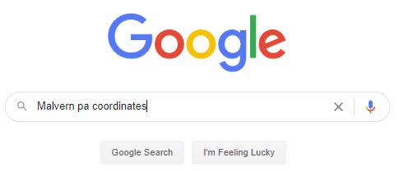

Data Sources
Wikipedia.com
Google
Foursquare API

Slide 5
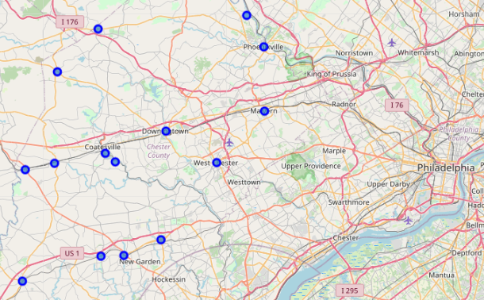
Tier 1 Analysis: Chester County, PA
Identify the boroughs
Atglen
Avondale
Downingtown
Elverson
Honey Brook
Kennett Square
Malvern
Modena
Oxford
Parkesburg
Pheonixville
South Coatesville
Spring City
West Chester
West Grove

Slide 6
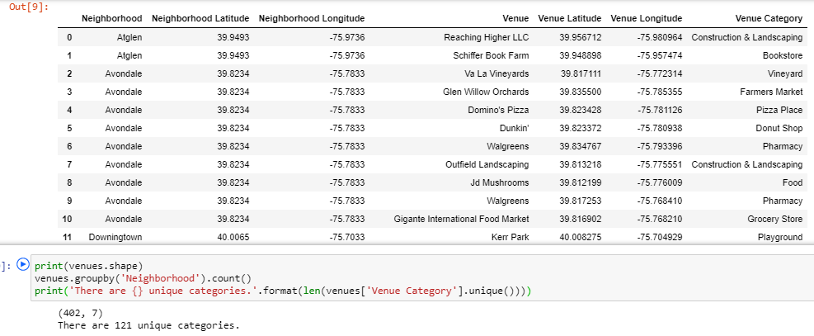
Tier 1 Analysis: Chester County, PA
Discover their Venues

Slide 7
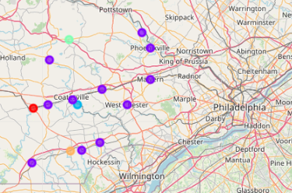
Tier 1 Analysis: Chester County, PA
Apply Machine Learning: K-Means

Slide 8
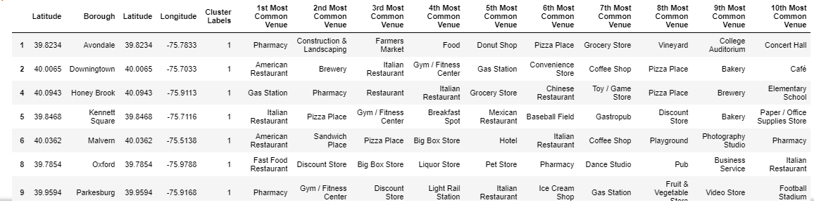
Tier 1 Analysis: Chester County, PA
Gather Cluster Data to Analyze

Slide 9
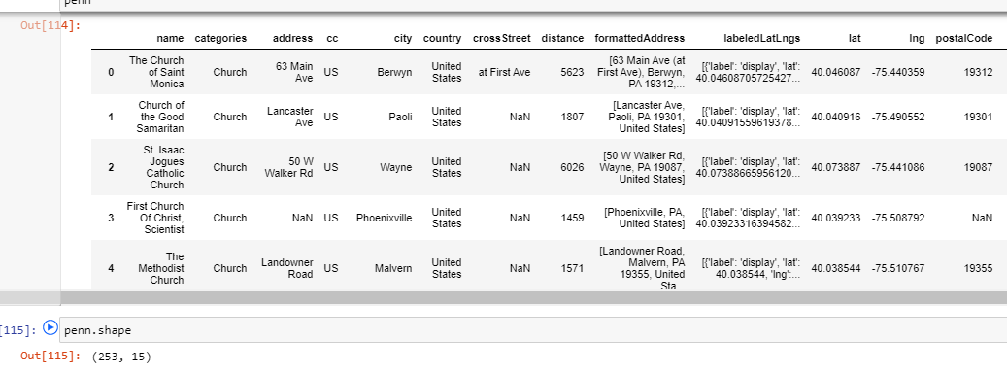
Tier 2 Analysis: Could Malvern, PA be a good fit?
Identify neighborhoods near Malvern
Search for venues within a 10 mile radius of each neighborhood
Combine data into one dataframe for analysis

Slide 10
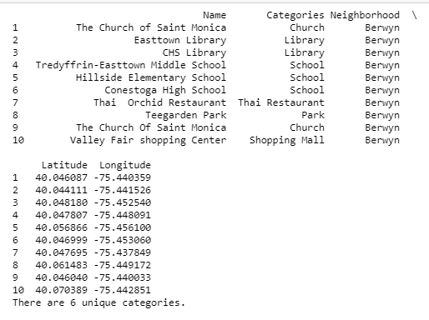
Tier 2 Analysis: Could Malvern, PA be a good fit?
Identify how many of the 11 unique venue categories are represented in each neighborhood
This is an example of an output for Berwyn, PA which is near Malvern. It has ten venues across six of the 11 unique categories

Slide 11
Tier 2 Analysis: Outcomes
Neighborhood Name | Number of Unique Categories
Audubon | 1
Berwyn | 6
Broomall | 3
Bryn Mawr | 2
Chester | 1
Chester Springs | 3
Chesterbrook | 2
Cheyney | 1
Collegeville | 4
Delaware County | 1
Devon | 4
Downingtown | 1
Eagleville | 3
East Whiteland Township | 1
Exton | 7
Frazer | 1
Neighborhood Name | Number of Unique Categories
Glen Mills | 3
King of Prussia | 7
Linfield | 1
Malvern | 10
Media | 3
Mont Clare | 0
Newtown Square | 7
Norristown | 8
Oaks | 2
Paoli | 5
Pheonixville | 8
Radnor | 2
Rehoboth Beach | 1
Royersford | 1
Spring City | 3
Strafford | 1
Neighborhood Name | Number of Unique Categories
Trappe | 1
Upper Providence | 1
Villanova | 2
Wayne | 6
West Chester | 8
West Norriton | 1

Slide 12
Results
Tier 1 Analysis:
A lot of the boroughs are similar
Wide variety of venues within the county
This gives the family in our example plenty of possible locations from which to choose
Tier 2 Analysis:
Malvern, PA has a high potential of being a good fit, having 10 of their 11 category venue preferences
This could make the family’s move and settlement into their new location easier

Slide 13
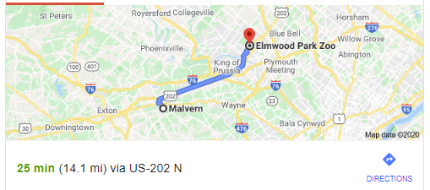
Discussion
Malvern appears to be a good fit for this particular family moving to Chester County, PA
Further analysis into Malvern, PA shows the missing venue category to be the “zoo”.
A Google search of the nearest zoo to Malvern showed that it was 14 miles away, 4 miles out of our desired 10 mile radius
If our family lived in the northeast side of Malvern, they may be able to have all 11 of their desired venue categories within a 10 mile radius

Slide 14
Conclusion
Its not easy relocating a family to a new state. Fortunately we can use machine learning and simple data analysis to uncover details about new locations and find the best neighborhood based on your family’s current lifestyle and preferences.
Thank you for viewing my IBM Coursera Capstone project.

